Slide 1

Machine learning in condensed
matter physics
管冬、黄玉清、袁瑞鑫、张子尧、李兴光、崔浩楠、何梦云、李宇
2019.11.12

Slide 2

Theoretical background
Well-known works
OUTLINE
Problems
Summary and outlook

Slide 3
PART
1
Theoretical background

Slide 4
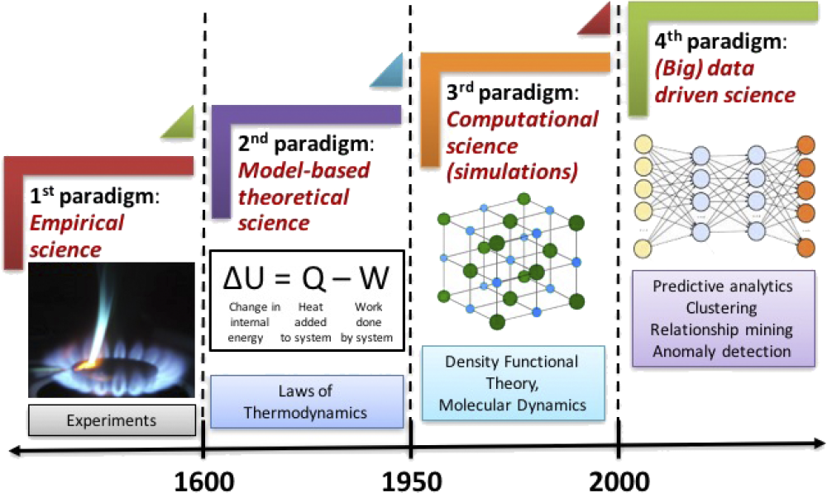
Agrawal, A. & Choudhary, A. Perspective: Materials informatics and big data: realization of the ‘fourth paradigm’ of science in materials science. APL Mater.4, 053208 (2016).

Slide 5
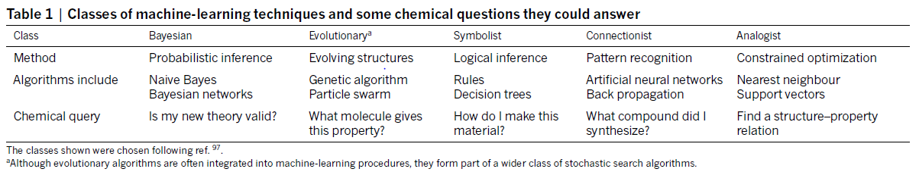
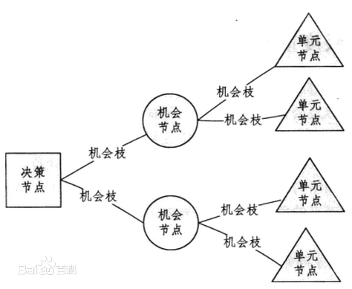
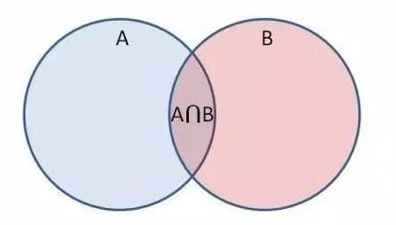
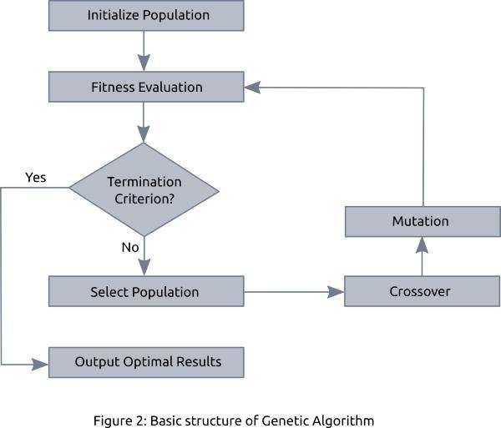

1. Naïve Bayes
2. Genetic algorithm
3. Rules Decision trees

Slide 6
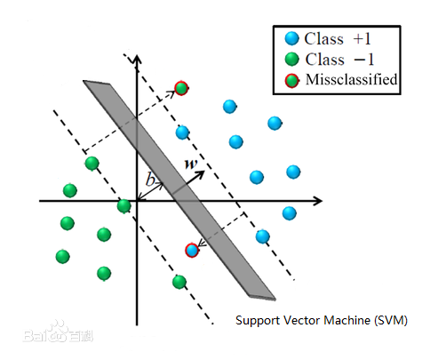
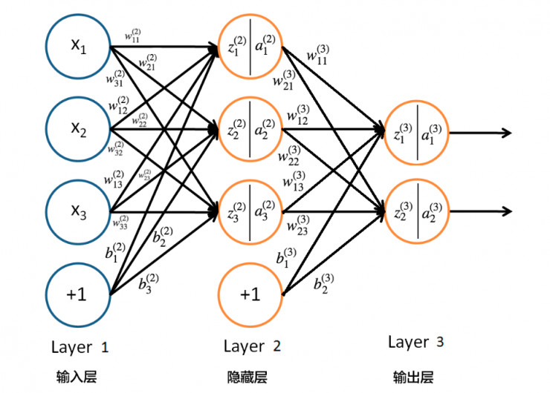
4. BP neural network
5. SVM

Slide 7
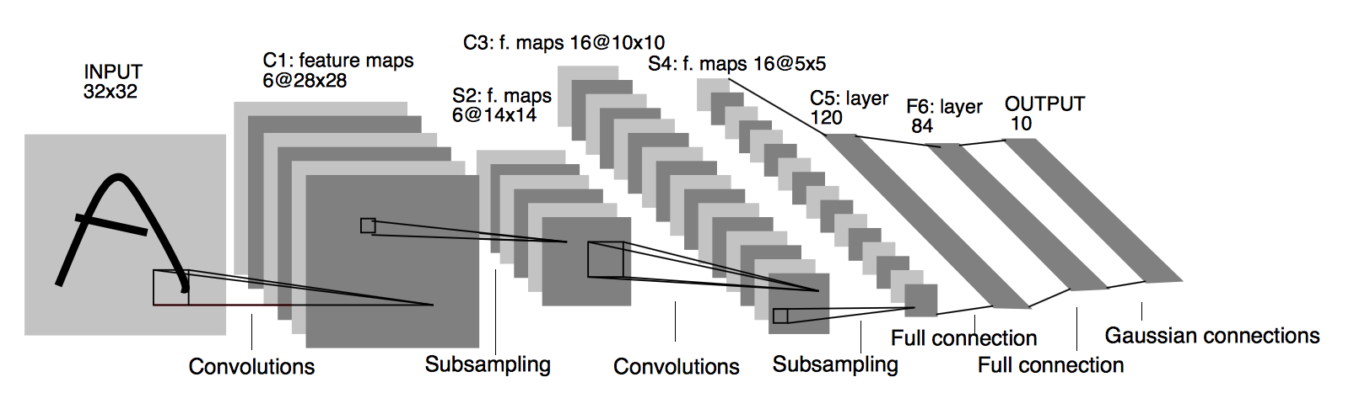
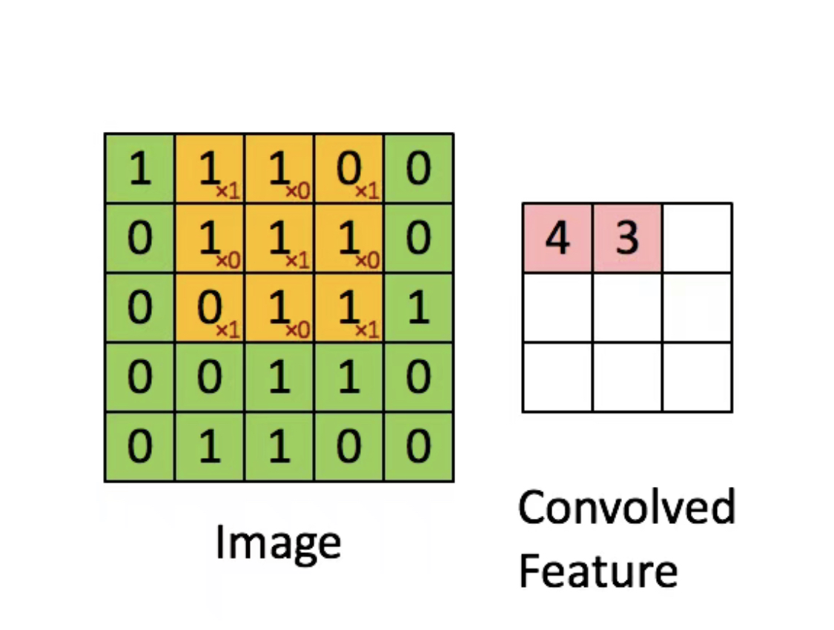
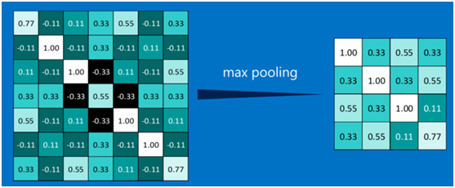
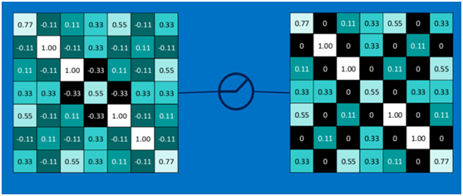
6. Convolutional neural network (CNN)
Convolution
Pooling
Rectified Linear Units

Slide 8
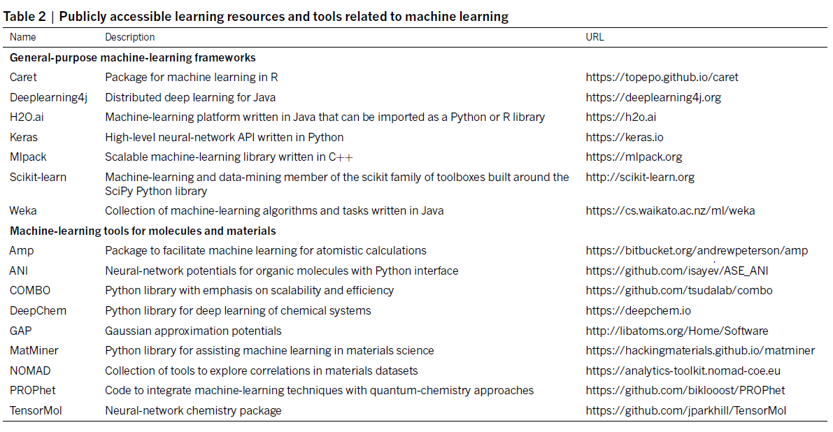

Slide 9
PART
2
Well-known works

Slide 10
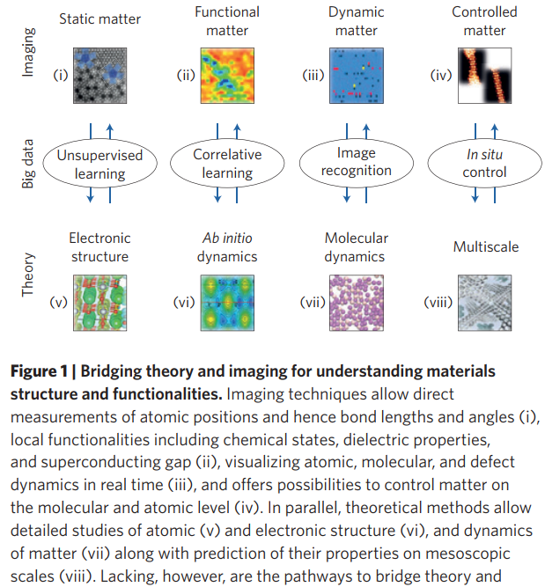
Kalinin,S.V.,Sumpter,B.G.&Archibald,R.K.Big–deep–smartdatainimaging for guiding materials design. Nat. Mater. 14, 973–980 (2015).

Slide 11

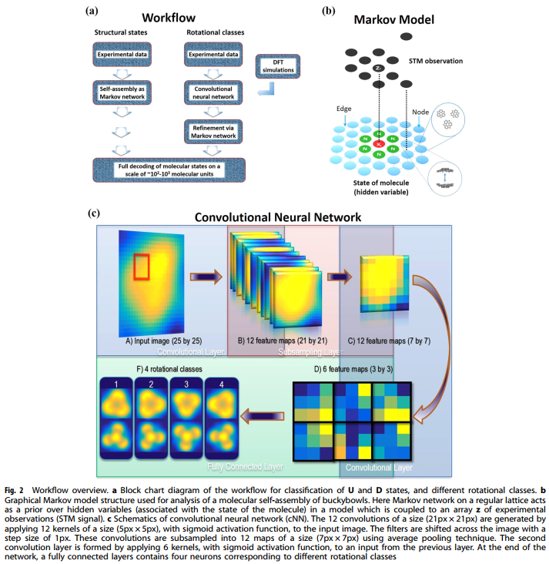
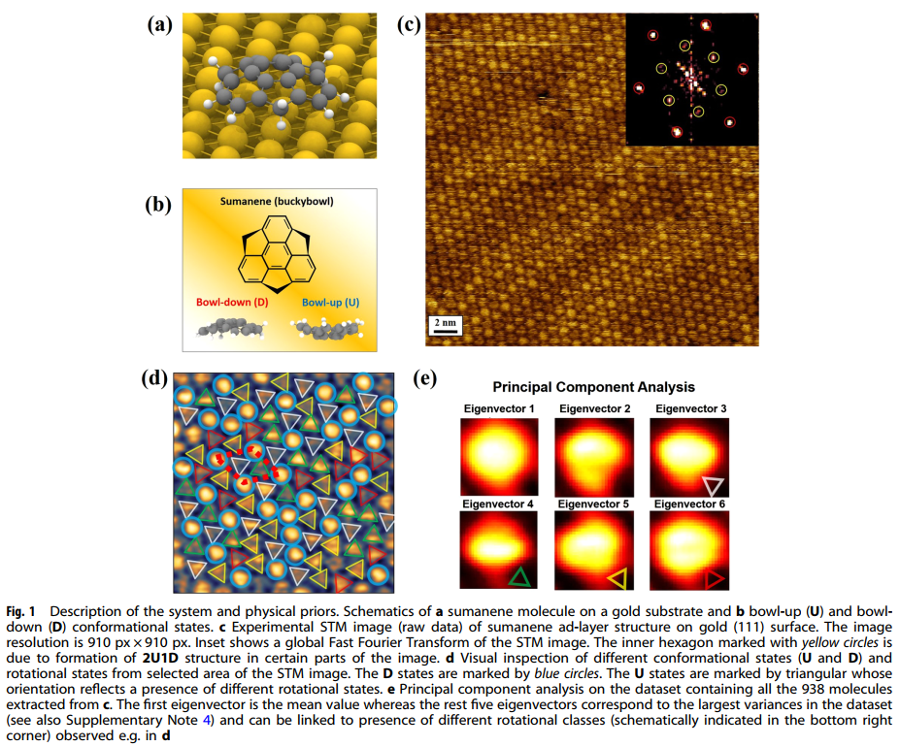
2.1
Ziatdinov, M., Maksov, A. & Kalinin, S. V. Learning surface molecular structures via machine vision. npj Comput. Mater. 3, 31 (2017).

Slide 12
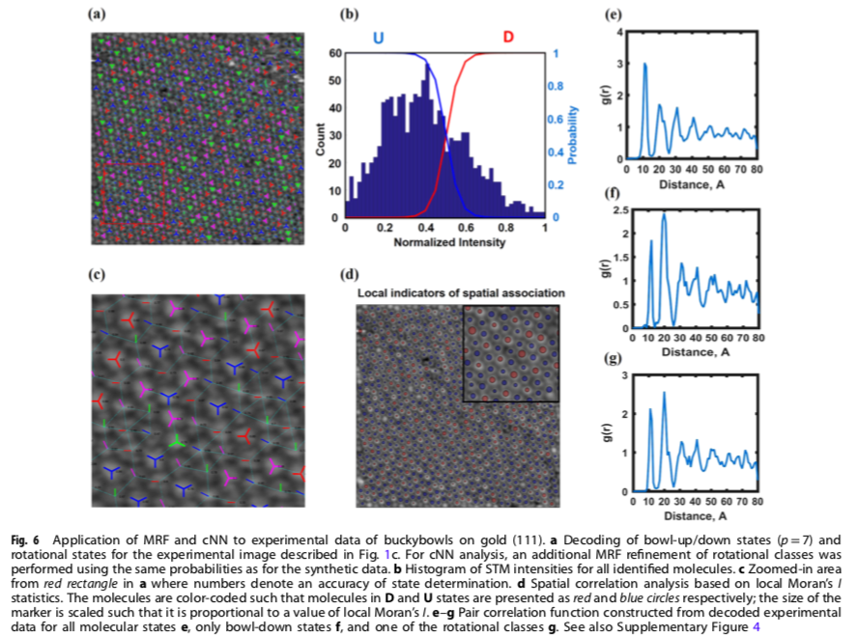
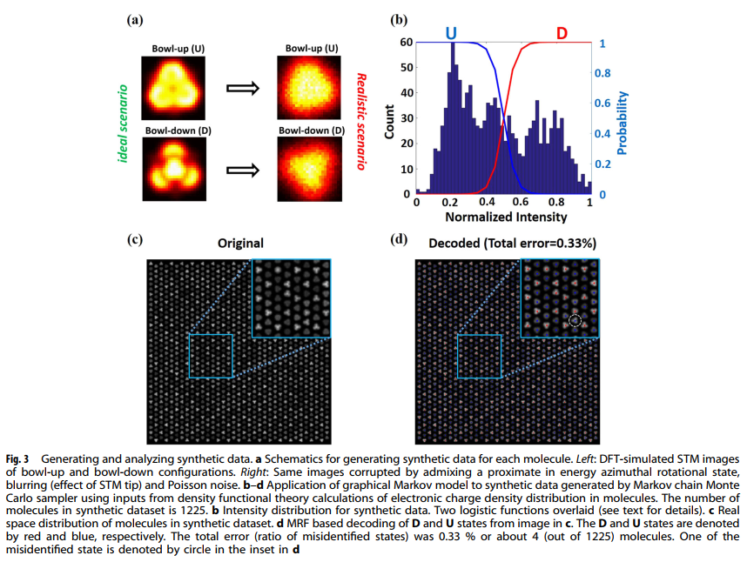
2.1
Ziatdinov, M., Maksov, A. & Kalinin, S. V. Learning surface molecular structures via machine vision. npj Comput. Mater. 3, 31 (2017).

Slide 13
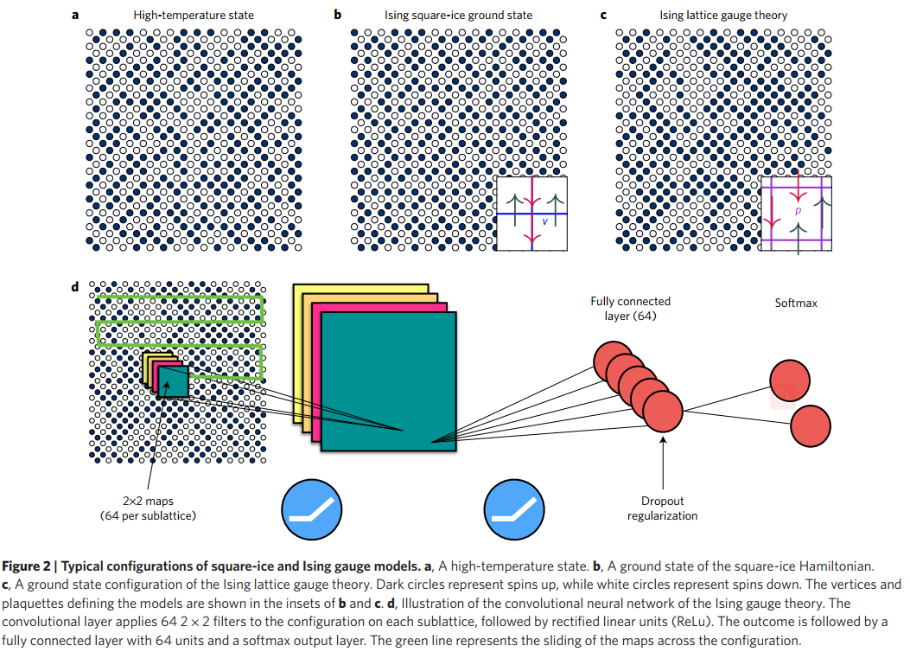
2.2
Carrasquilla, J. & Melko, R. G. Machine learning phases of matter. Nat. Phys. 13,431–434 (2017).

Slide 14
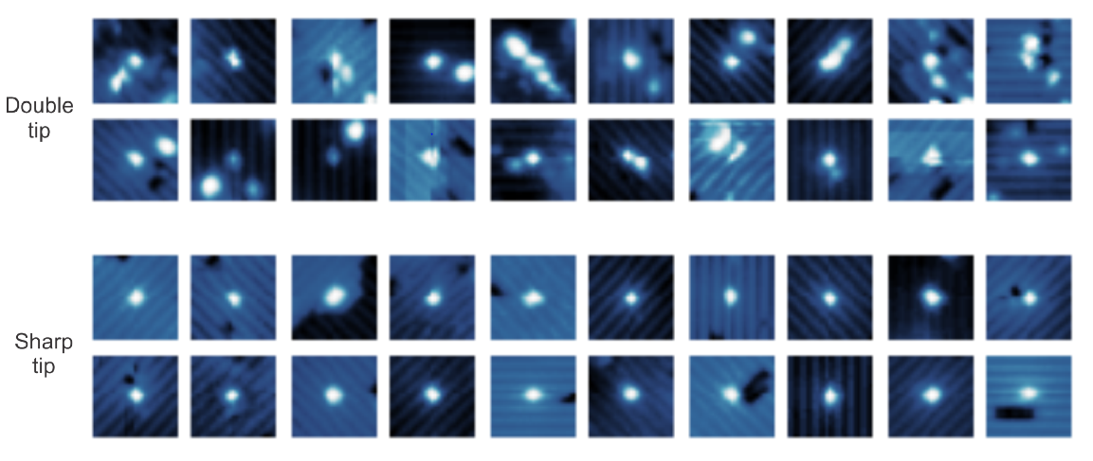
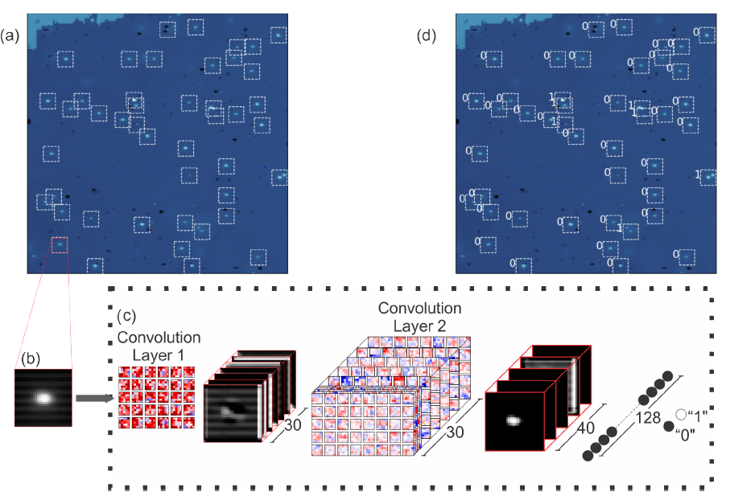
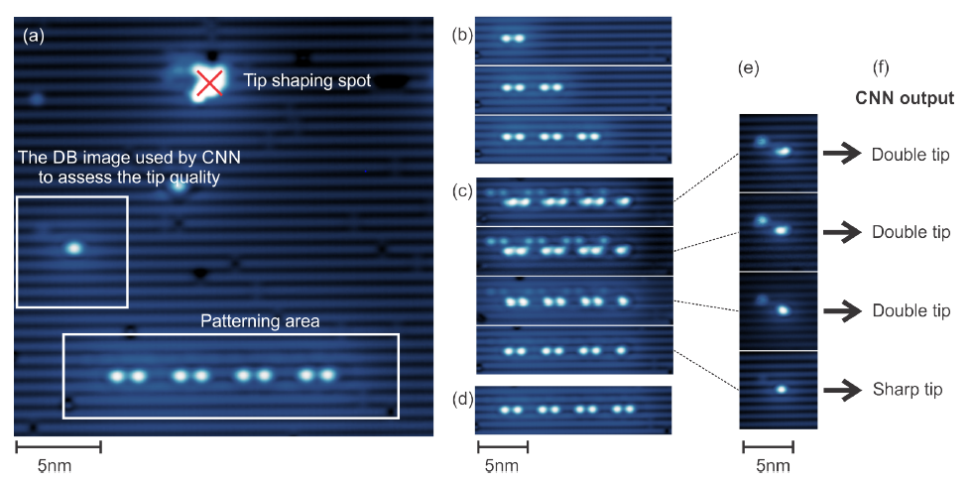
2.3
Rashidi M, Wolkow R A. Autonomous scanning probe microscopy in situ tip conditioning through machine learning[J]. ACS nano, 2018, 12(6): 5185-5189.

Slide 15
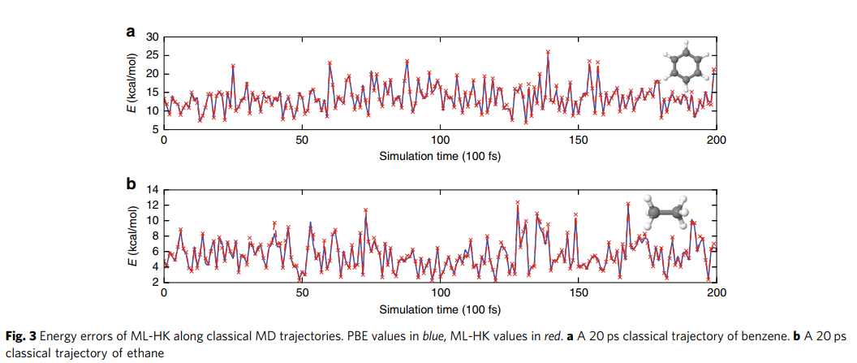
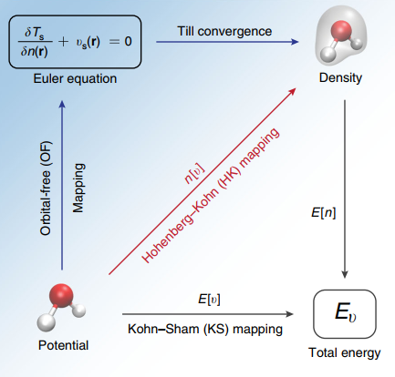
2.4
Brockherde, F. et al. Bypassing the Kohn-Sham equations with machine learning. Nat. Commun. 8, 872 (2017).

Slide 16
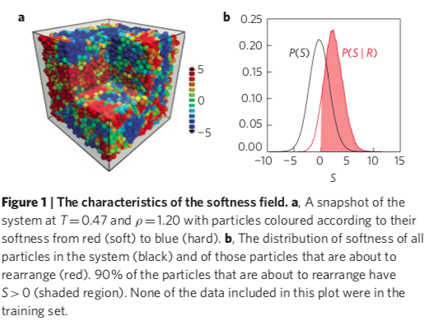
2.5
Schoenholz S S , Cubuk E D , Sussman D M , et al. A structural approach to relaxation in glassy?liquids[J]. Nature Physics, 2016.

Slide 17
2.6
Segler, M. H. S., & Waller, M. P. (2017). Neural-Symbolic Machine Learning for Retrosynthesis and Reaction Prediction. Chemistry – A European Journal, 23(25), 5966-5971. doi:10.1002/chem.201605499

Slide 18
PART
3
Problems

Slide 19
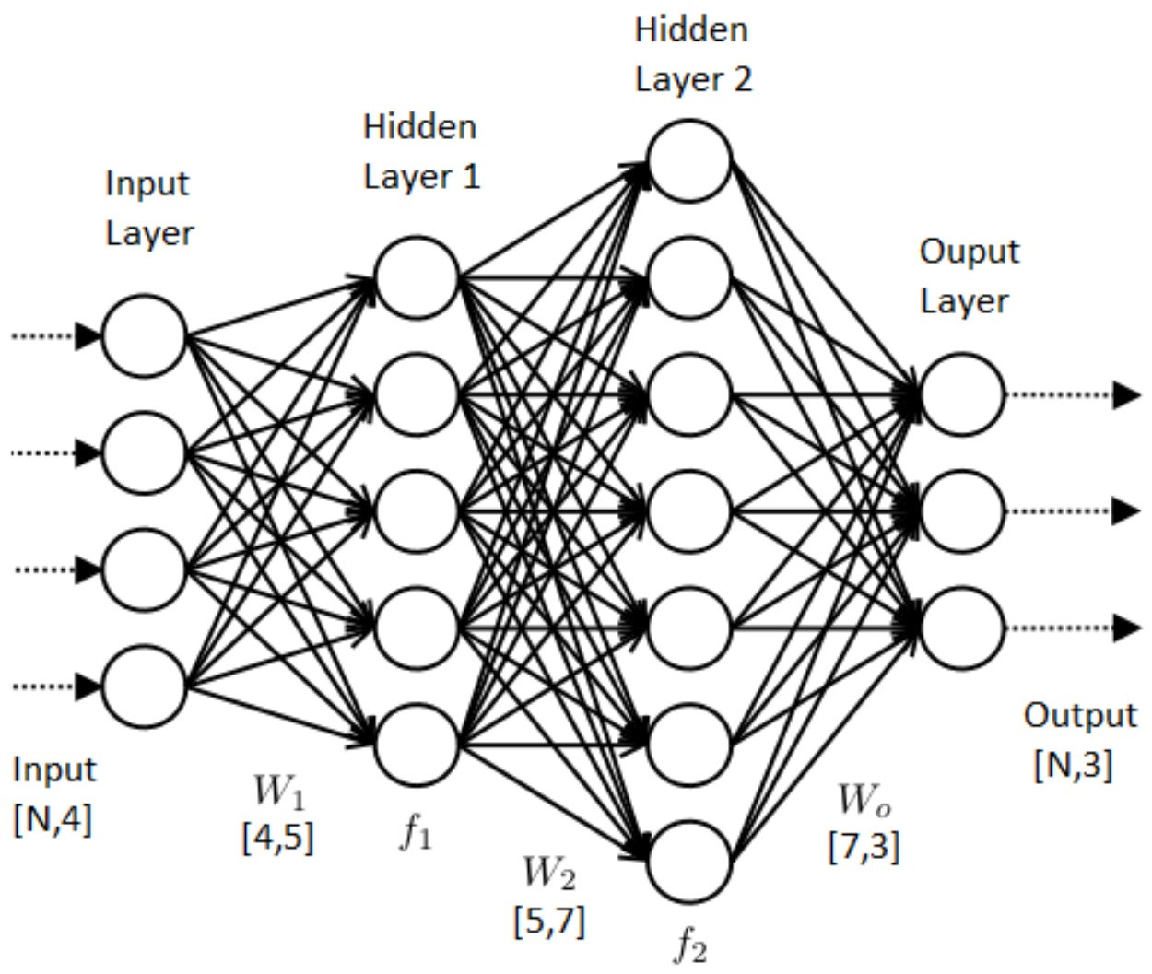
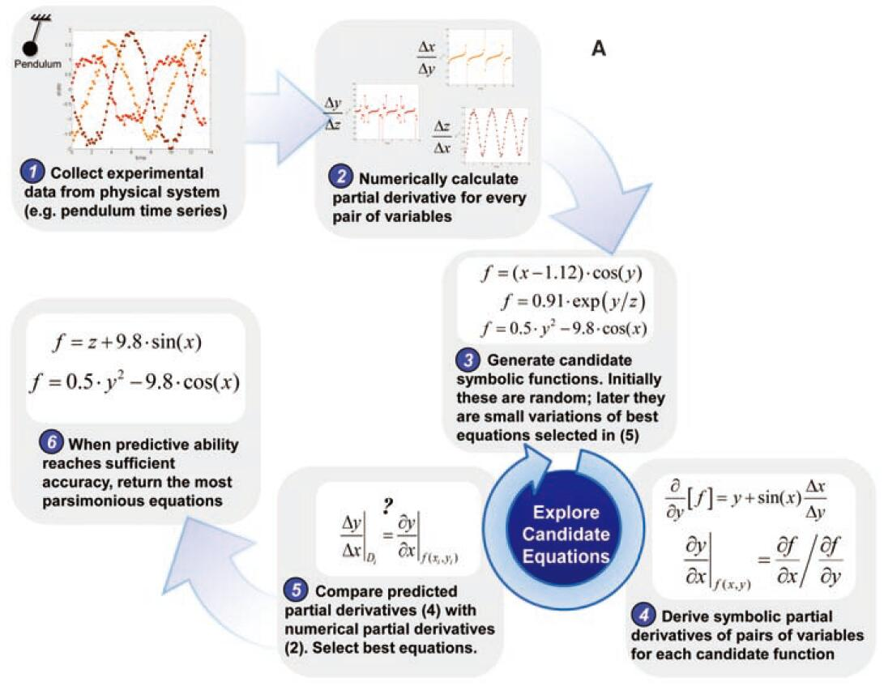
Weight: W₀, W₁, W₂

Slide 20
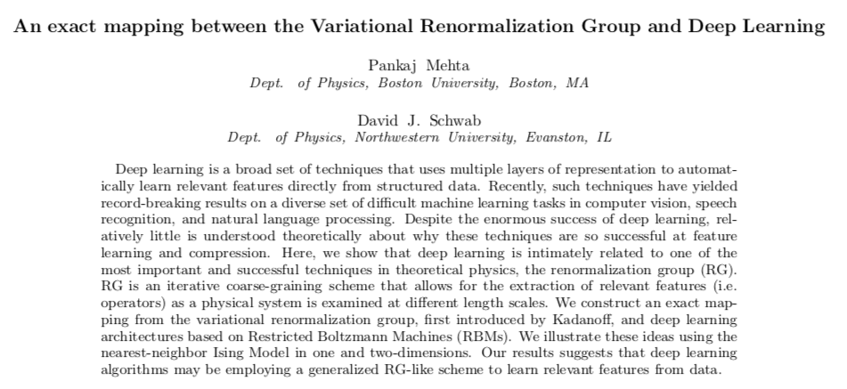

Slide 21
PART
4
Summary & outlook

Slide 22
Summary & outlook
Review of the basics of machine-learning approaches
Progress in the application of machine learning to address challenges in molecular and materials research
Developments that are required to enable more wide-ranging impacts

Slide 23
Thanks~

